Slide 1
K-Means Clustering

Slide 2
What is Kmeans?
K-means clustering is a type of unsupervised learning, which is used when you have unlabeled data (i.e., data without defined categories or groups).
The goal of this algorithm is to find groups in the data, with the number of groups represented by the variable K.
The algorithm works iteratively to assign each data point to one of K groups based on the features that are provided.
Data points are clustered based on feature similarity.

Slide 3
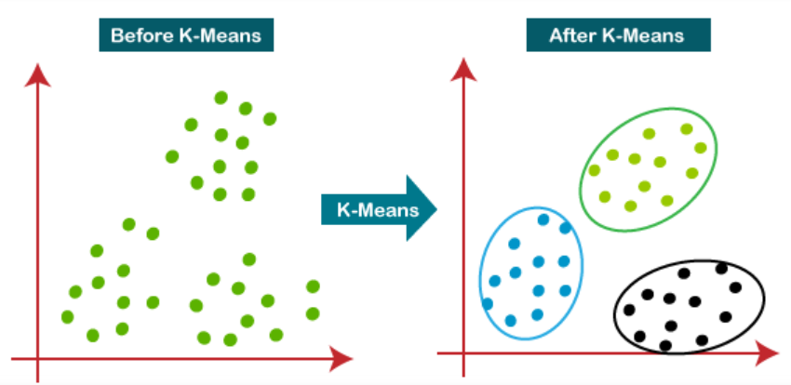

Slide 4
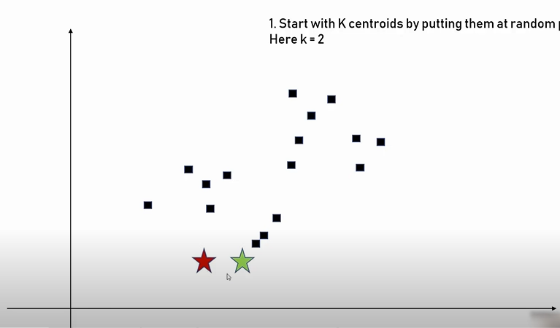
Step 1: Identify 2 random points i.e center of cluster or centroids

Slide 5
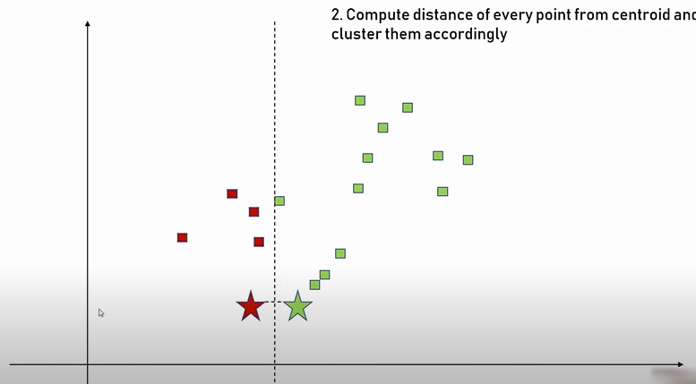
Step 2: Identify the distance from data points to centroids. If data point is nearer to red cluster than it belongs to that cluster

Slide 6
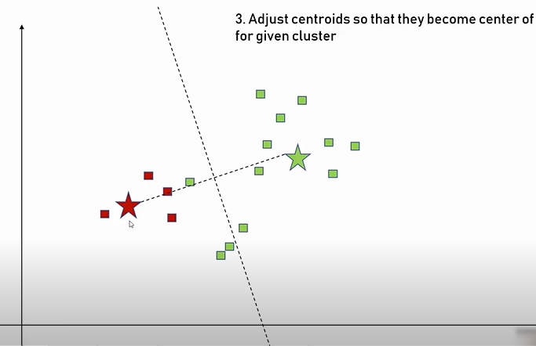
Step 3: Adjust the cluster to move to center of gravity for given cluster

Slide 7
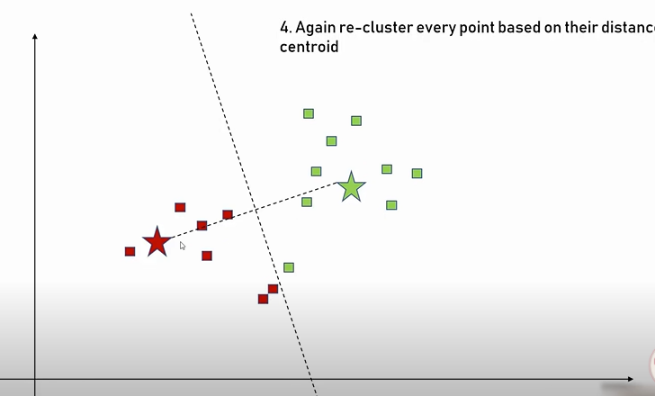
Step 4: Again re-cluster every point based on their distance with centroid

Slide 8
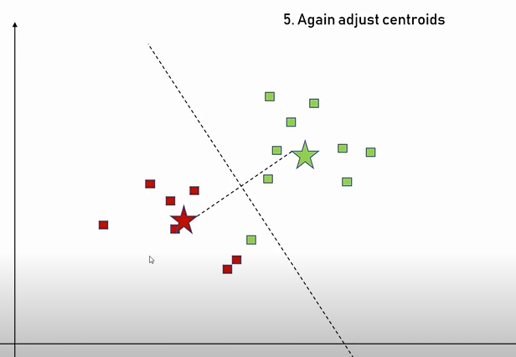
Step 5: Again adjust the centroids

Slide 9
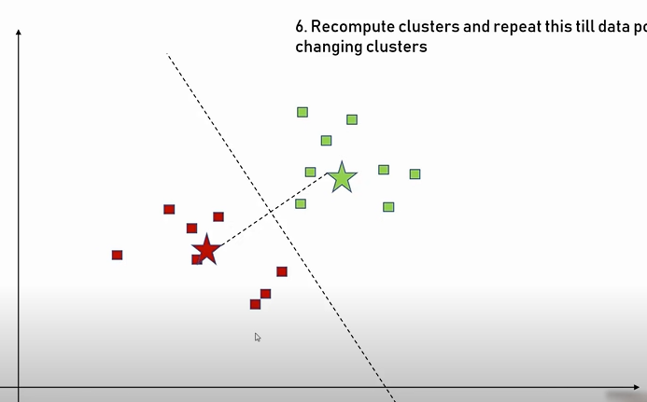
Step 6: Recompute clusters and repeat this till data points stop changing clusters

Slide 10
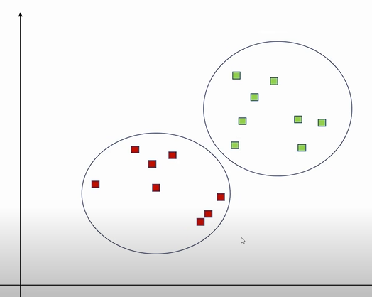
Final Cluster

Slide 11
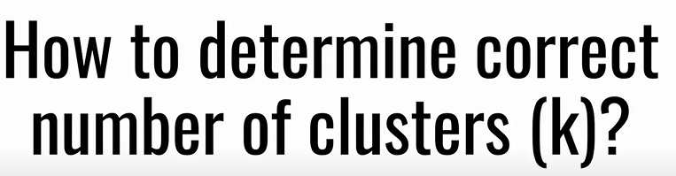
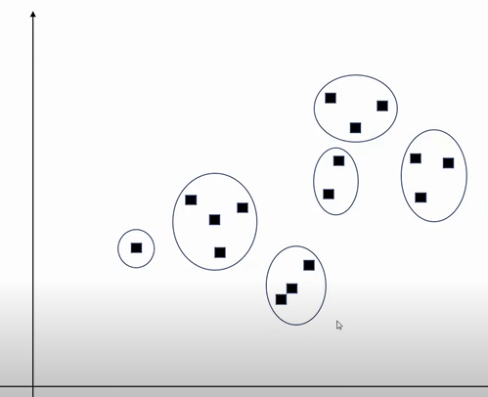
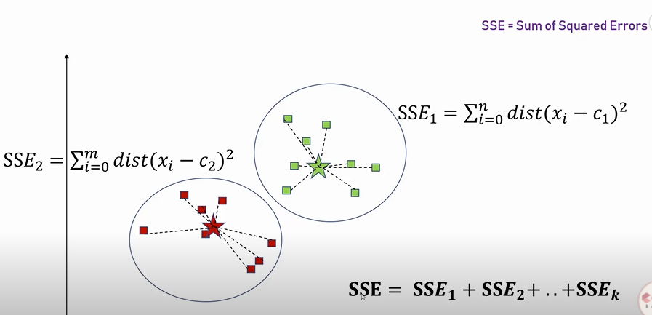
ELBOW Methods

Slide 12
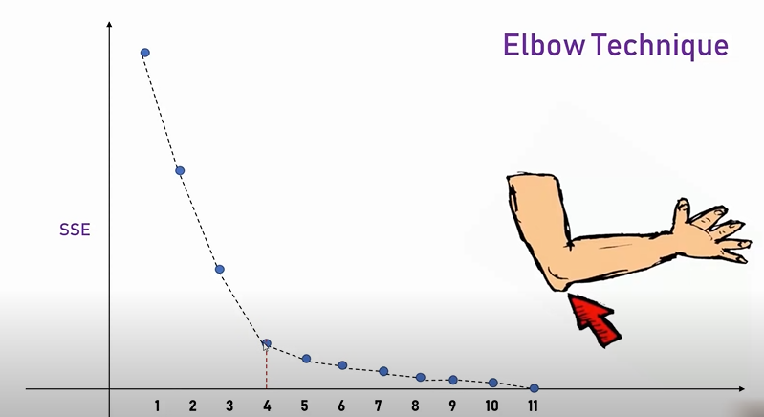

Slide 13
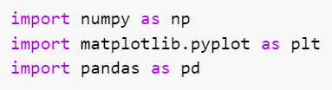


Importing the libraries
Importing the dataset

Slide 14
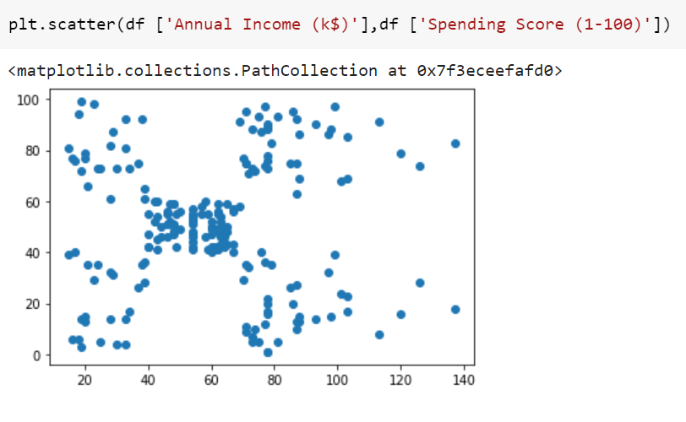
Visualize the data

Slide 15
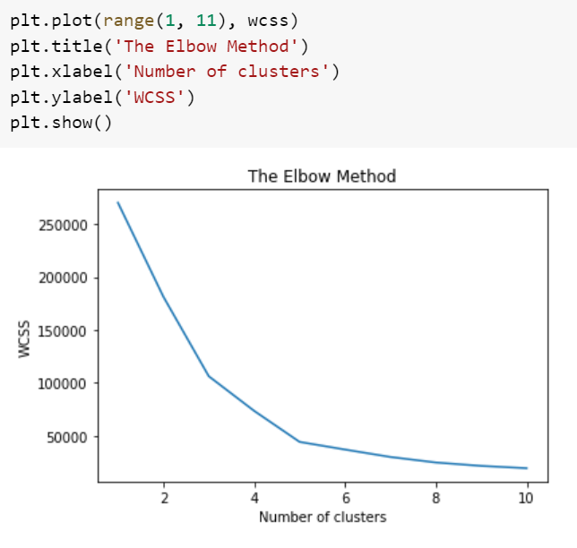
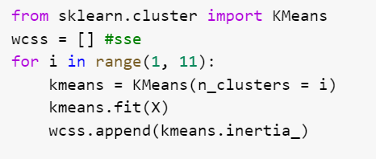
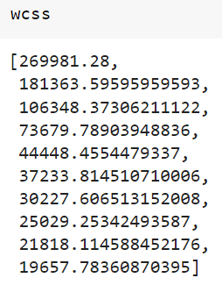
Using the elbow method to find the optimal number of clusters

Slide 16
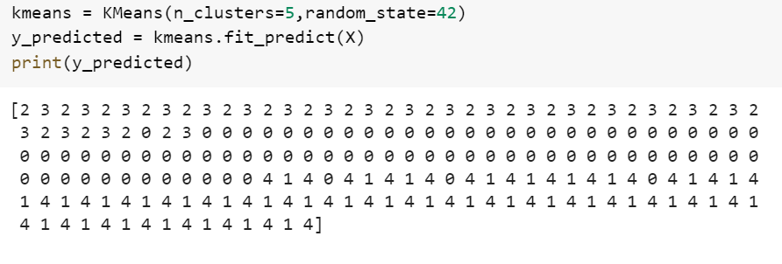
Training the K-Means model on the dataset

Slide 17
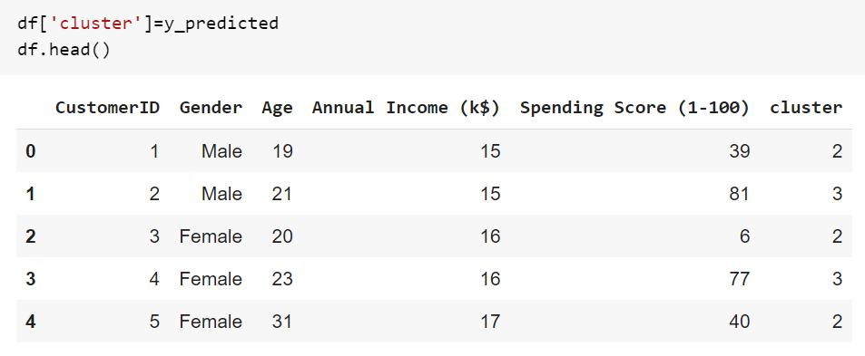
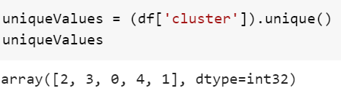

Slide 18
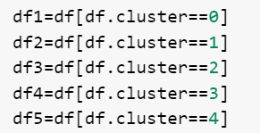
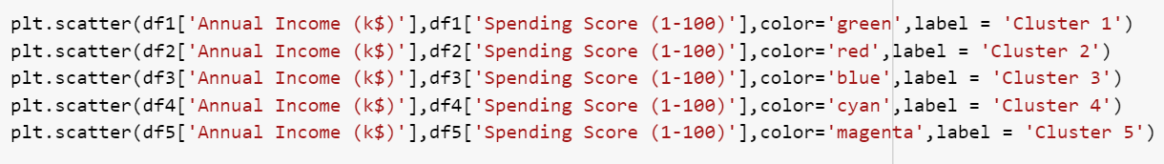
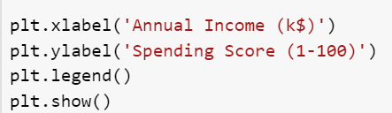
Visualising the clusters

Slide 19
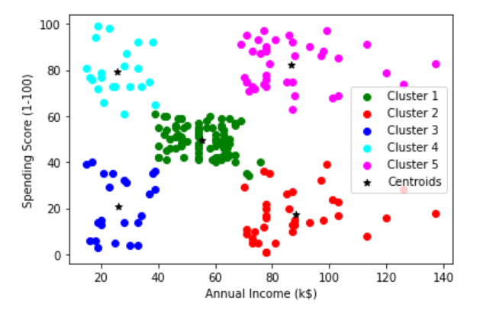
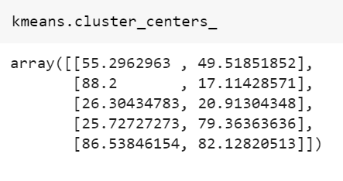

Slide 20
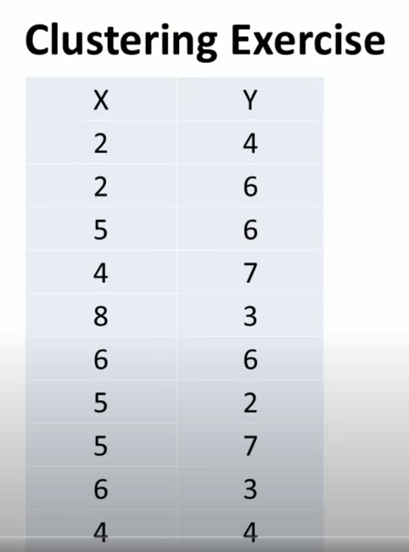

Slide 21
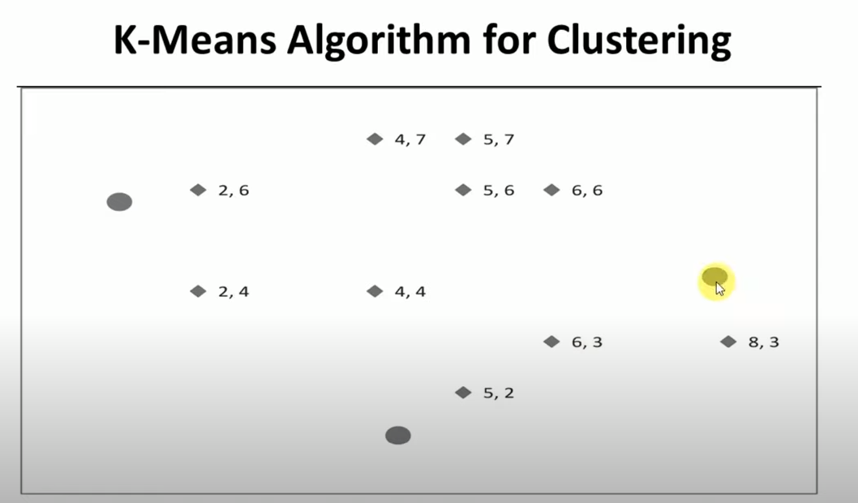

Slide 22
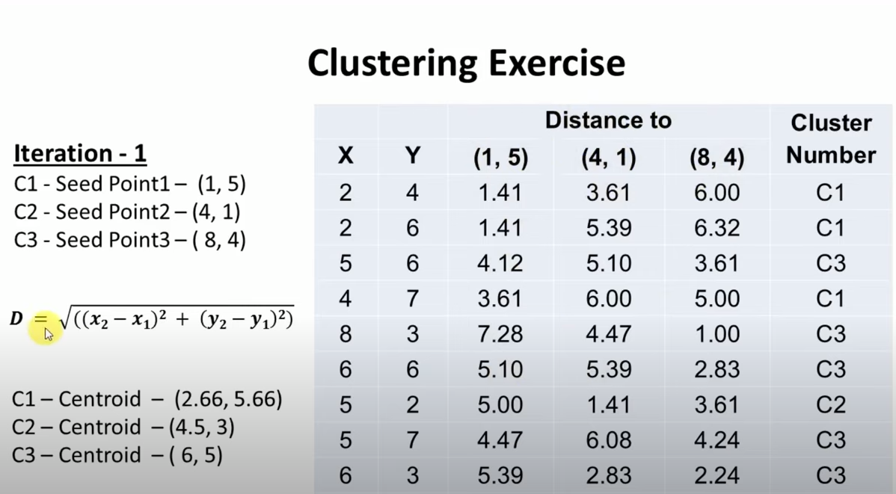

Slide 23
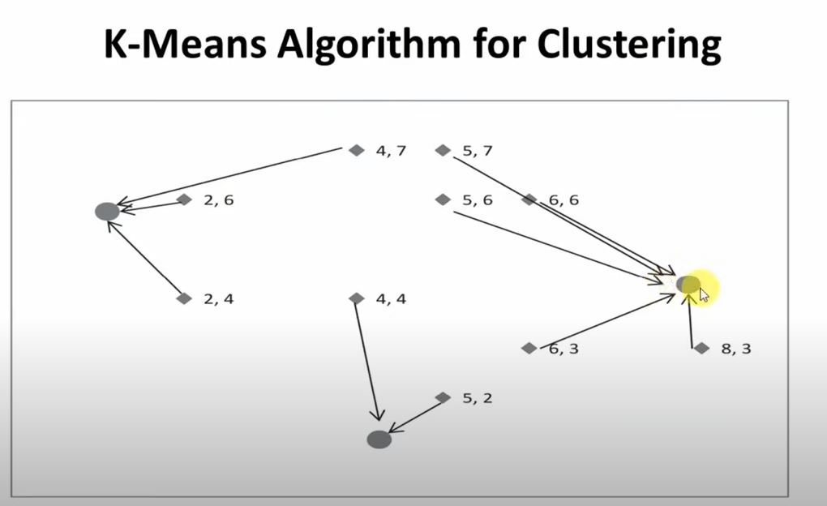

Slide 24
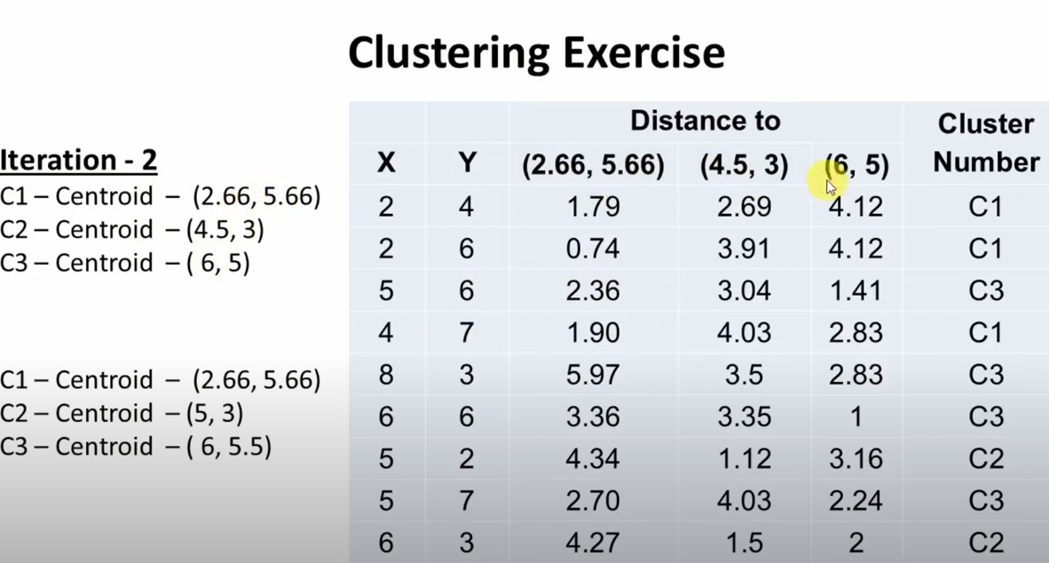

Slide 25
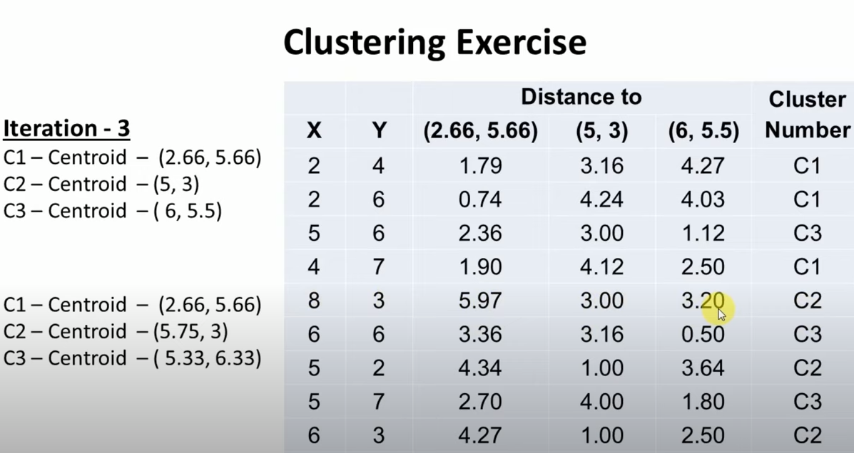

Slide 26
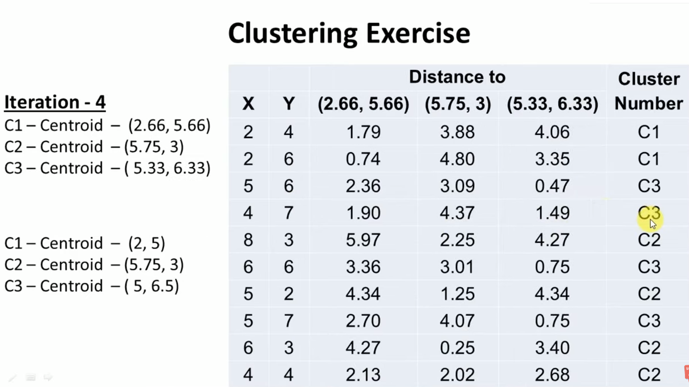

Slide 27
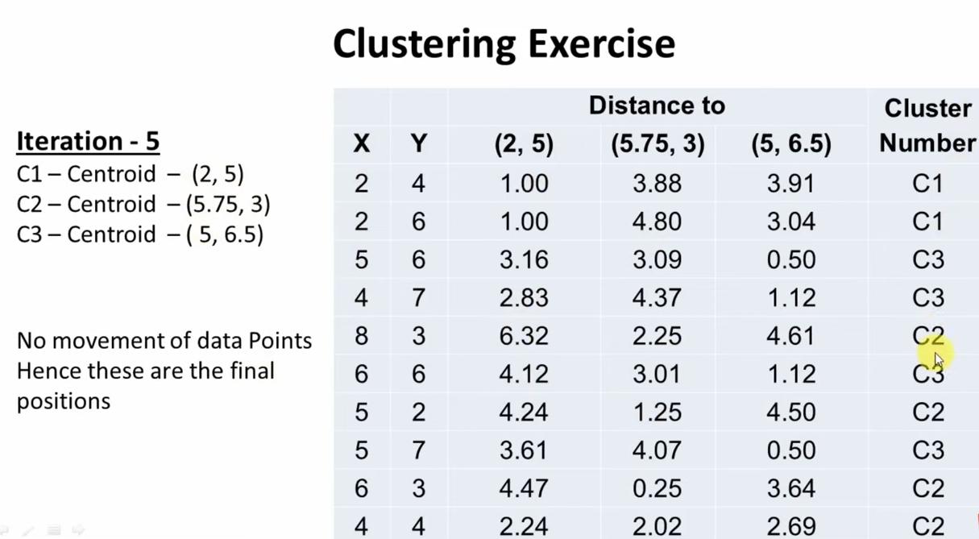

Slide 28
